Slide 1
CHAPTER 5 Predictive Control with constraints 7 independent model GPC
Anthony Rossiter

Slide 2
Background
So far the constraint code and development has covered a simple GPC algorithm, with and without a T-filter, and DMC.
It was noted in the previous video that simple changes in prediction equations lead to relatively simple changes in how constraint handling is achieved.
This chapter will look at the use of an independent model form for prediction, using the prediction equations and unconstrained algorithms derived in chapter 2.

Slide 3
GPC optimisation
GPC control law is defined by the following cost function, predictions and constraints.

Slide 4
Independent model structure
A model is simulated in parallel with the real process.
Predictions are based on the model input/output and the offset term (see video 10 of chapter 1).

Slide 5
Predictions with an independent transfer function model
The underlying model can be transfer function or state space (or indeed other forms).
Considering TF formats first.

Slide 6
IM GPC with TF predictions
Substituting predictions into J gives the following:

Slide 7
GPC optimisation with independent model
GPC control law is defined by the following QP:

Slide 8
MATLAB code
Key files for supporting independent model GPC using transfer functions are:
imgpc_constraints_tfmodel.m – BUILD CONSTRAINT MATRICES
imgpc_tf_law.m – DEFINE PARAMETERS OF J
imgpc_tf_simulate_constraints.m – RUN SIMULATION AND PRODUCE FIGURES
CODE IS IN INDEPENDENT MODEL MPC FOLDER
Worth comparing to standard GPC with and without a T-filter.

Slide 9
video5_7_example1.m
Simple example to demonstrate the code works.
Same example as video5_4_example1.m and viewers will note same responses as no uncertainty.

Slide 10
video5_7_example2.m
Simple example to demonstrate the code works.
Same example as video5_5_example4.m and viewers will note similar responses.
Output constraints ignored where infeasible due to large disturbance.

Slide 11
video5_7_example3.m and video5_7_example4.m
Compare noise rejection with GPC with a T-filter. Similar benefits.
MIMO example for completeness.
VIEWERS can edit these codes to develop their own examples and comparisons as they desire.

Slide 12
video5_7_example4.m
Simple MIMO example to demonstrate the code works.
Same example as video5_5_example7.m and viewers will note similar responses.
Behaviour noticeably different from that with T-filter – this is because the disturbance/noise model is different.
However, input constraints are satisfied throughout.

Slide 13
State space IM
Reminder that in chapter 2 for this case we used a slightly different J, although of course the user is free to define their own performance index (and predictions) to suit their own needs.
Rather than redefining all the inequalities in terms of the control u_{k} rather than its increment, these steps are left to the viewer as they are straightforward.

Slide 14
video5_7_example5.m
Simple example to demonstrate the code works.
State space model independent model code is in imgpc_simulate.m.
No output constraints in this code.
Add yourself if wanted.

Slide 15
Summary
This video has shown how constraints can be incorporated into an independent model from of GPC, using transfer function models.
Some MATLAB code is provided, although viewers should easily be able to edit the existing code should they want this.
The only substantive change from GPC is the change in the prediction equations. The key point is the addition of the disturbance estimate which impacts on the performance index and also the definition of the constraint inequalities.

Slide 16



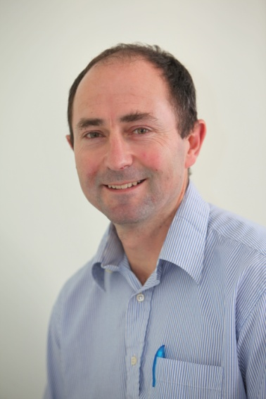
Anthony Rossiter
Department of Automatic Control and Systems Engineering
University of Sheffield
www.shef.ac.uk/acse
© 2014 University of Sheffield
This work is licensed under the Creative Commons Attribution 2.0 UK: England & Wales Licence. To view a copy of this licence, visit http://creativecommons.org/licenses/by/2.0/uk/ or send a letter to: Creative Commons, 171 Second Street, Suite 300, San Francisco, California 94105, USA.
It should be noted that some of the materials contained within this resource are subject to third party rights and any copyright notices must remain with these materials in the event of reuse or repurposing.
If there are third party images within the resource please do not remove or alter any of the copyright notices or website details shown below the image.
(Please list details of the third party rights contained within this work.
If you include your institutions logo on the cover please include reference to the fact that it is a trade mark and all copyright in that image is reserved.)

